Slide 1
NOTE: Please download these slides locally to your PC. Do not edit the main document.
Thank you!

Slide 2

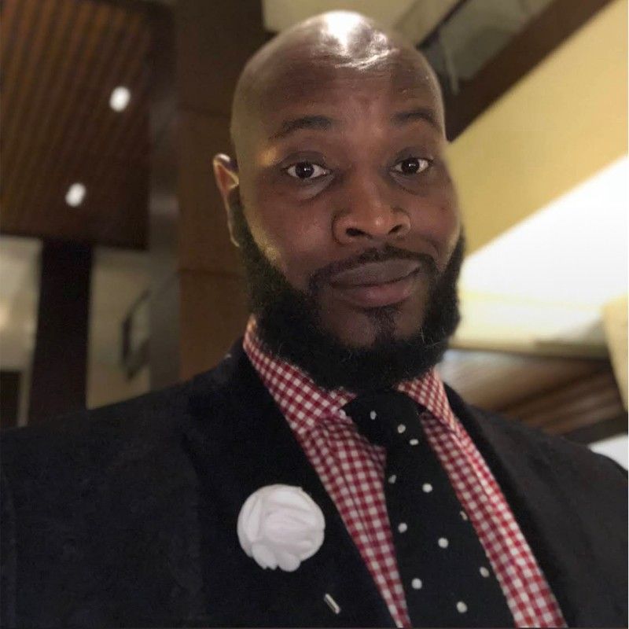
PeopleShores Tech Hub Apprentice
Apprentice Story – Before Apprenticeship (Looking to understand what led you to the Apprenticeship program) ​
​
How did you learn about the PeopleShores x Accenture Apprenticeship Program?​
My Teacher from Erwin Tech introduced me and my class to this opportunity​
What was your occupation before joining the program?​
I worked as a train conductor for Norfolk Southern
Did you experience any challenges along the way that made this opportunity life changing?​
My biggest challenge was trying to learn so much so fast and telling myself I got this
Were you apart of any organizations that helped position you for the program?​
​
​
Apprentice Story – During Program ​
​
What was your favorite part of the program?​
What did you learn during your Apprenticeship Experience?​
That with hard work you can learn how to do this data stuff ​
Additional Info – After Apprenticeship​
​
Carlton Powell Sr
Data Engineer
Tampa ATC
Linkedin
2

Slide 3

Carlton Powell sr.
Data engineer
RELEVANT SKILLS
RELEVANT EXPERIENCE
Computer Competencies:
Word, Excel, Project, PowerPoint, SQL, Python, Azure
Certifications:
Sec+, CEH, Azure AI
Industries: Military, Transportation
<PeopleShores Apprenticeship (Capstone)>
<03/25> - <06/25>
Responsibilities: I managed the ETL process for critical credit card and loan application data, leveraging Python, SQL, and PySpark to ensure data was meticulously cleaned, transformed, and efficiently loaded into a MySQL database. Furthermore, I designed and developed an intuitive, menu-driven console application. This application empowered users with seamless capabilities to view, update, and analyze customer and transaction data directly.
Contributions: Enhanced data insights by creating compelling visualizations that effectively highlighted critical trends, such as high-spending customer segments and prevalent loan decision patterns. Improved data integrity and accessibility by ensuring high levels of data accuracy and providing a user-friendly interface that significantly simplified data interaction and exploration for stakeholders.
BACKGROUND
Interests:
My career began in the U.S. Navy, specializing in bomb and missile systems, which cultivated a disciplined approach and meticulous attention to detail under pressure.
I then transitioned to the railroad industry as a conductor, where I developed strong skills in operational management, safety, and communication. This diverse background offers a unique blend of technical acumen, leadership, and adaptability.
Education/Bootcamp:
EXAMPLE: Intellectual Point –Cybersecurity, Erwin Tech Cloud Computing Fundamental boot camp, Par Scholas Data Engineer
<Erwin Tech, Cloud Computing>
<04/24> - <02/25>
Responsibilities: During my time at Erwin Tech, I focused on cloud computing fundamentals from AZURE/AWS Cloud and the basics of artificial intelligence while preparing for the AI Fundamentals certifications. Through coursework and practical exercises, I gained a solid understanding of how Microsoft Azure services and AI tools are applied in real-world scenarios.
Contributions: I successfully earned My Azure AI certifications that validated my Knowledge in AI concepts. This enabled me to effectively support projects by applying foundational cloud and AI skills. my time at Erwin Tech, I focused on cloud computing fundamentals and the basics of artificial intelligence while preparing for the
CONTACT INFORMATION
Office Location: Tampa ATC 140 Fountain Pkwy,
St Pete
Email: Carlton.Powell@accenture.com

